Slide 1
IBM Data Science Capstone Project The Battle of Neighborhoods
Open a new Yoga center in Toronto city
Madhu Pottabathula

Slide 2
Business Problem
In this project a hypothetical business problem of a client from Ontario Canada will be addressed by presenting some viable options resulting from the data analysis of the available data using Machine Learning techniques.
One local businessman who lives in Ontario Canada (client) wants to invest and open a new Yoga center in Toronto city. Client has a concept in his mind and a fair idea about Toronto city setting, but would like to get some advice in choosing a best location from his perspective to open a new Yoga center and therefore needs help.
During an initial meeting, client has discussed the business goal that is in his mind and defined some criterion for selecting a spot for Yoga center like listed below.
Specifics
It should be located in urban setting like within city limits
Within the 15 minutes walking distance from the city center
As close as possible to other popular places in the area and it is as crowded as possible where we can expect heavy foot traffic
There should be less or no competition
He needs a place where labor is available easily at reasonable salaries.
In what best location Neighborhood and/ or borough should he open a Yoga center to have the best chance of being successful

Slide 3
Data gathering and Data wrangling
Toronto city Neighborhood Data
Toronto city data will be scrapped and collected from the following Wikipedia page: https://en.wikipedia.org/wiki/List_of_postal_codes_of_Canada:_M.
Geographical coordinates data for each Neighborhood in Toronto:
The following csv file will give us the geographical coordinates (Longitude and Latitude) of each postal code: http://cocl.us/Geospatial_data
The information pulled above will be transformed into a pandas data frame
Data Cleaning
FourSquare API will be utilized to obtain all the location data related to neighborhoods and popular venues in the surrounding area along with other details.
FourSquare location data
Data will be obtained in Json file format and will be parsed using Python code to convert it into datasets.
The data gathered will be cleaned to remove the duplicate data
Data records with incomplete data will be discorded
Some empty data will be replaced with other known values or common data values
Only required data that is identified will be used for data analysis

Slide 4
Process and Methodology
Below is the step by step process followed to perform the data analysis and all other Machine learning techniques used to arrive at a solution to the defined business problem addressing all the client requirements.
Data collection and wrangling to create required data sets for the data analysis (data sources and details discussed in the data section above)
Utilize the Foursquare API to fetch location data such as venues in a given point, popularity, ratings, tips etc.
Use One-hot encoding to find out most common venues and group the rows by neighborhood and by taking the mean of the frequency of occurrence of each category
Execute K-means clustering algorithm to segment neighborhoods into required number of clusters
Visualizing neighborhood clusters using Folium library
Perform Data Analysis and derive insights from the results to arrive at a solution to the given Business Problem
Finally recommend a viable solution to the client

Slide 5
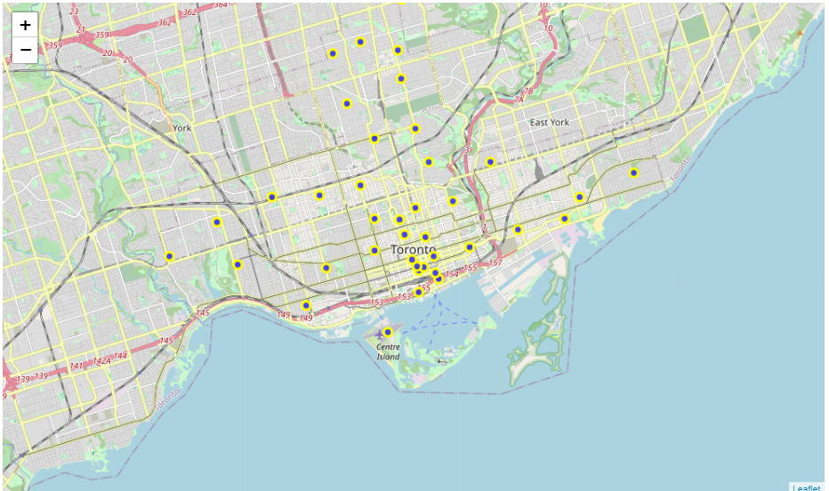
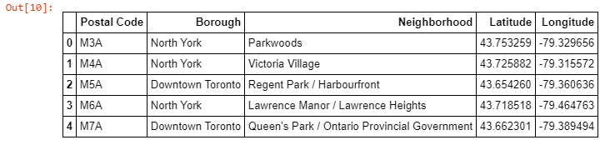
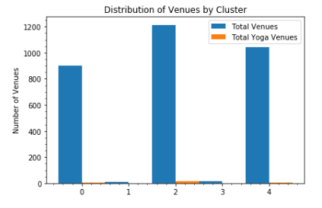
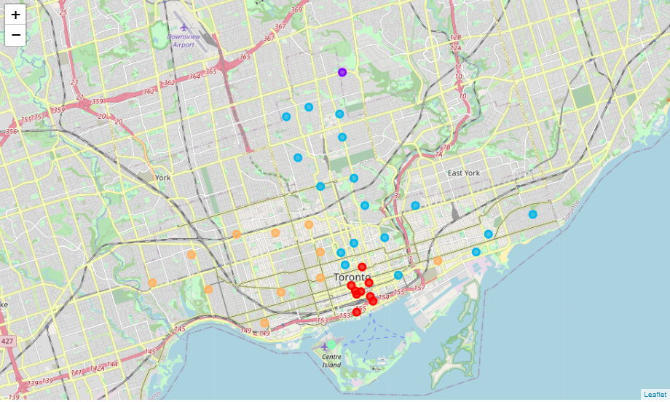
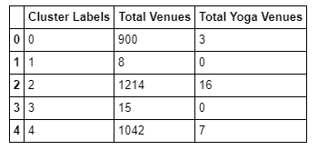
Results – Few Samples (Refer to Notebook for complete results)
Initial Data Frame for data analysis
Neighborhood locations represented on Toronto city map
Data Frame constructed for best location determination for new Yoga Center
Clusters represented after performing K-Means analysis

Slide 6
Recommendations
Insights
Clusters 0, 2 and 4 are appear to be very busy areas having many existing venues
Clusters 0, 2 and 4 are more or less equally popular based on the number of Venues that each of these Clusters has
Clusters 1 and 3 appear to be less popular considering the number of Venues each has, we can eliminate these two clusters from consideration
clusters 2 and 4 have more number of Yoga centers established already and the cluster 0 has less numbers of Yoga centers
Competition in Cluster number 0 is less compared to other two Clusters 2 and 4
After careful consideration of the data and the insights after data analysis, Cluster 0 found to be the suitable area for establishing a new Yoga center in Toronto city being the popular area with less competition. Finally the Client has been advised and recommended that a new Yoga Center can be established in any of the following 9 Neighborhoods in the Downtown Borough:
Garden District, Ryerson
St. James Town
Berczy Park
Richmond / Adelaide / King
Harbourfront East / Union Station / Toronto Islands
Toronto Dominion Centre / Design Exchange
Commerce Court / Victoria Hotel
Stn A PO Boxes
First Canadian Place / Underground city
Recommendations

